Slide 1
Classes 7, 8
Policies and Institutions: International by
Alan V. Deardorff
University of Michigan
2020
PubPol/Econ 541

Slide 2
Announcement
Quizzes
  Clarify my expectations:
    Feel free to look up anything you like from course or other sources.
    But write your answers yourself and do not work with other students.
  Should I extend time from 30 min to, say, 45?
  Note the real deadline is Saturday midnight

Slide 3
Announcement
Quizzes
  Results:
 | Q1 | Q2 | Q3
Mean | 8.74 | 7.10 | 6.68
Median | 9 | 7 | 6.5
Max | 10 | 10 | 10
Min | 5.5 | 2 | 3
S.D. | 1.20 | 1.75 | 2.04

Slide 4
Announcement
Papers
  Avoid “spurious specificity”
    Nothing here is known exactly
    So don’t report more than a few (3?) significant digits
    Eg, “$162 million”
      NOT “$161.629 million”
      NOT “$161,629,418

Slide 5
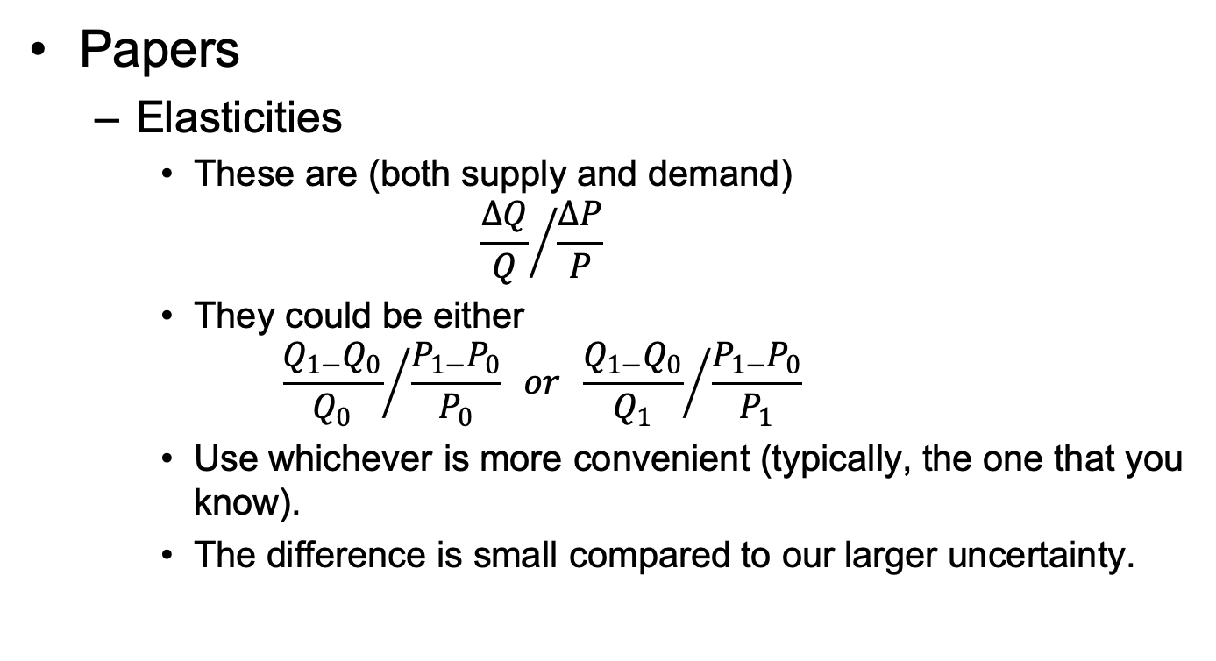
Announcement
Papers
  Elasticities
    These are (both supply and demand)
    $${\frac{∆Q}{Q}}/{\frac{∆P}{P}}$$
    They could be either
    $${\frac{Q_{1−}Q_{0}}{Q_{0}}}/{\frac{P_{1−}P_{0}}{P_{0}}} or {\frac{Q_{1−}Q_{0}}{Q_{1}}}/{\frac{P_{1−}P_{0}}{P_{1}}}$$
    Use whichever is more convenient (typically, the one that you know).
    The difference is small compared to our larger uncertainty.

Slide 6
Announcement
For those attending from China:
  UM has a new service, MLane, to make access easer.
  More information is at:
    https://its.umich.edu/enterprise/wifi-networks/mlane

Slide 7
Outline
The Problem
History
GATT
WTO
  Early Issues
  Current Issues (Trump)
Other Institutions

Slide 8
The Problem
Countries think they can benefit themselves at the expense of others by using tariffs
But all lose if all do
It’s a Prisoners’ Dilemma

Slide 9
The Problem of Trade Warfare
 | Japan
US |  | Free Trade |  | Protection
Free Trade |  |  | 10 |  | 20
 |  | 10 |  | –10
Protection |  |  | –10 |  | –5
 |  | 20 |  | –5

Slide 10
The Outcome
Countries use tariffs, and all are worse off
The solution: Cooperation
  Bilateral
    Pairs of countries agree to reduce tariffs on each other
    They worry partners will do better deals with others later
    So they promise “Most Favored Nation”
    Promise partners the best they do later for others
  Multilateral: GATT, and later WTO

Slide 11
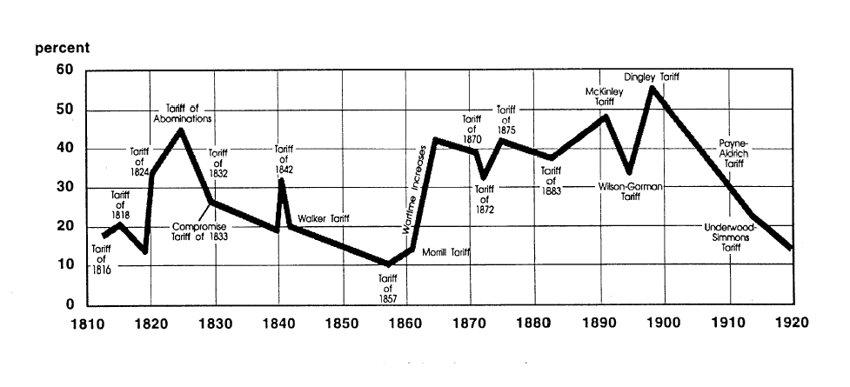
US tariff history: 1810-1920
Today
landandfreedoml.org
Notes:
Source: landandfreedom.org

Slide 12
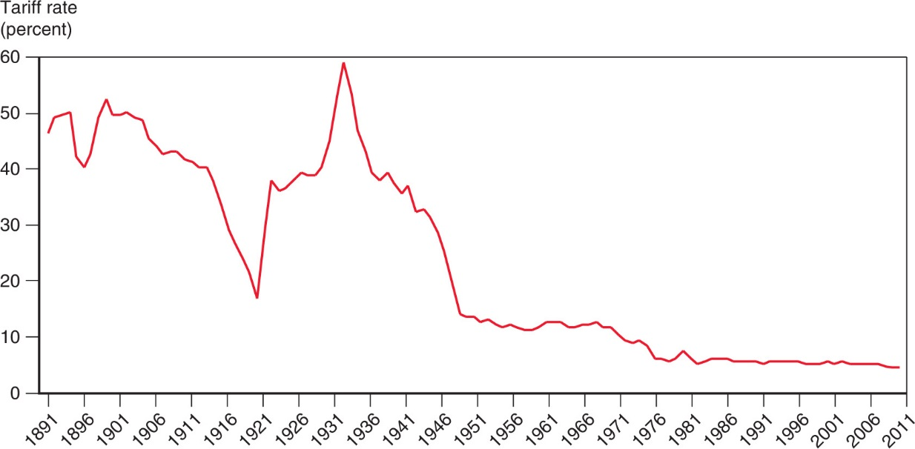
Figure 10.5 The U.S. Tariff Rate
Smoot-Hawley Tariff
1934 Reciprocal Trade Agreements Act
1947 GATT
1995 WTO
After rising sharply at the beginning of the 1930s, the average tariff rate of the United States has steadily declined.

Slide 13
History
Before 1934
  Massive use of tariffs
    Especially by US
    Often for government revenue
  1930: Smoot-Hawley Tariff
    Prompted retaliation by others
    Worsened Great Depression

Slide 14
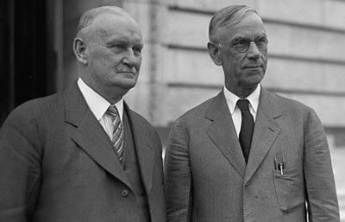
Hawley
Smoot

Slide 15
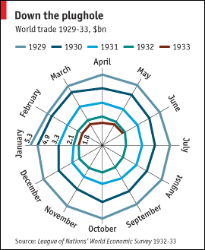
Kindleberger Spiral
Source: Economist, “The battle of Smoot-Hawley,” December 18, 2008.

Slide 16
History
1934: Reciprocal Trade Agreements Act
  US Congress authorized President to negotiate bilateral tariff reductions
  Used MFN to spread tariff cuts to, and from, multiple countries

Slide 17
History
1947: General Agreement on Tariffs and Trade (GATT)
  Accompanied (but not part of) the Bretton Woods negotiations that created
    IMF
    World Bank
  Meant as temporary until International Trade Organization (ITO) would be ratified.
    ITO failed (in US)
  Adopted via Protocol of Provisional Application

Slide 18
Pause for Discussion

Slide 19
  Questions
What reasons may motivate countries to use tariffs on imports?
By how much were US tariffs reduced from the 1930s to just after World War II, just before the GATT? How was this accomplished?
What do KOM mean by the “levers” and the “ratchets”?

Slide 20
GATT
What GATT does
  Sets rules for countries to follow in their trade policies
  Includes weak enforcement of rules
  Hosts “Rounds” of multilateral negotiations

Slide 21
GATT Negotiations
Rounds of GATT Multilateral Trade Negotiations
No. | Years | Name | Accomplishments
1-5 | 1947-61 |  | Reduced tariffs
6 | 1964-67 | Kennedy | Tariffs + anti-dumping
7 | 1973-79 | Tokyo | Tariffs + NTBs
8 | 1986-94 | Uruguay | Tariffs, NTBs, Services, Intellectual Property, Textiles, Ag., Dispute Settlement, Created WTO
9 | 2001-15 | Doha | FAILED: Doha Development Agenda

Slide 22
GATT Negotiations
How negotiations took place
  Tariffs:
    In early rounds, tariff cuts were negotiated between “principal supplier” country and “principal demander” country
      Cuts are extended to all other members (MFN)
      But large countries dominated this process
    In more recent rounds, negotiations start with a formula for tariff cuts, then negotiate exceptions

Slide 23
GATT Negotiations
Swiss Formula:
Z = AX/(A+X)
    X = initial tariff rate
    A = coefficient and maximum tariff rate
    Z = resulting lower tariff rate
  Proposed by Switzerland in Tokyo Round
  Reduces high tariffs more than low tariffs

Slide 24
Pause for Discussion

Slide 25
  Questions
What is the date of the Jackson book?
Was it written before or after:
  The expansion of world trade?
  The appearance of global supply chains?
  The creation of the WTO?
  The creation of the internet / web?
  The proliferation of Free Trade Agreements?

Slide 26
WTO
World Trade Organization
  Created by Uruguay Round, in 1994
  Went into effect Jan 1, 1995
  Members 2020: 164
    Latest: Afghanistan in 2016
  Led by Director General
    Position currently open
    Little power

Slide 27
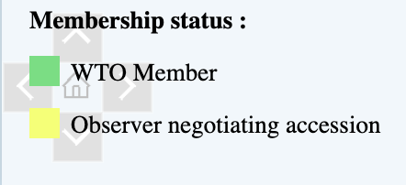
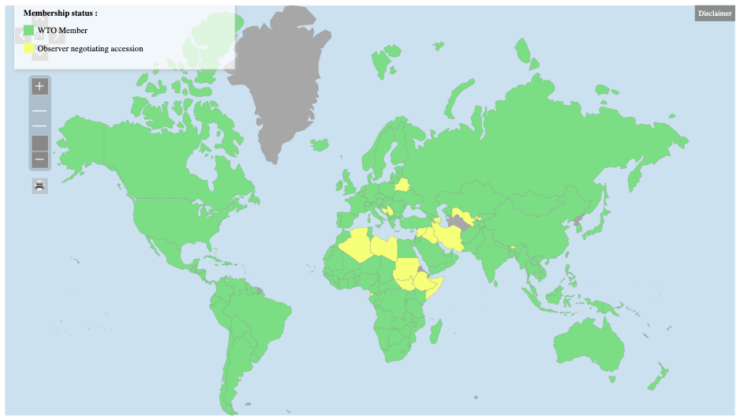
WTO
Notes:
https://www.wto.org/english/thewto_e/whatis_e/tif_e/org6_e.htm

Slide 28
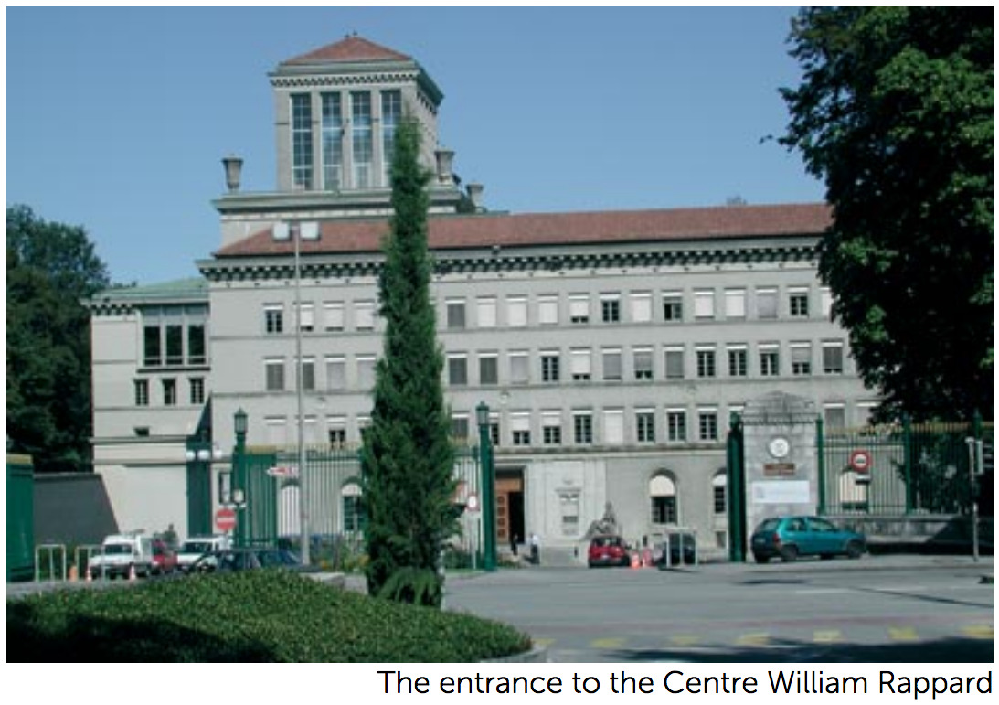

Slide 29
WTO
How it works
  Decides by “consensus”
    = “no member present objecting”
    Otherwise fraction (2/3 or 3/4) of members
  In practice, major countries decide
  Ministerial meetings every two years
2 Fundamental principles
  MFN = Most Favored Nation
  National Treatment

Slide 30
Pause for Discussion

Slide 31
  Discussion Question
What do you think the world of trade would be like now if we hadn’t had the GATT/WTO?

Slide 32
WTO
Three parts:
  GATT = General Agreement on Tariffs and Trade
  GATS = General Agreement on Trade in Services
  TRIPs = Trade-Related Aspects of Intellectual Property Rights
Functions (see below)

Slide 33
WTO Functions
Functional Outline of the World Trade Organization
Communication
Constraints
Exceptions
Dispute Settlement

Slide 34
WTO Functions
Communication | Ministerials
 | Negotiating Rounds
 | Working Groups
 | Trade Policy Review Mechanism
 | Councils and Committees
Trade Ministers (USTR, etc.) Meet Every Two Years
Tariff Reductions; Changes in Rules

Slide 35
WTO Functions
National Treatment for Service Firms (only in some industries)
Constraints | Tariff Bindings
 | Customs Valuation
 | Product Regulations
 | Quantitative Restrictions
 | Subsidies
 | Foreign Direct Investment (TRIMS)
 | Services (GATS)
 | Intellectual Property (TRIPs)
Countries negotiate and commit to maximum tariffs
Enforce Patents, Copyrights, Trademarks

Slide 36
WTO Functions
Most commonly used
Exceptions | Anti-Dumping
 | Countervailing Duties
 | Safeguards
 | Balance of Payments Protection
 | Preferential Trade Agreements
Permitted; not required
Allows NAFTA, EU, etc.

Slide 37
WTO Functions
Standing Committee that reviews most cases
Dispute Settlement | Consultation
 | Panel Recommendation
 | Appellate Body
 | Remedy | Implementation
 |  | Compensation
 |  | Retaliation
3-person Panel Decides Case
The Ultimate Remedy: Permit Tariffs

Slide 38
Pause for Discussion

Slide 39
  Questions
Jackson lists 11 important achievements of the Uruguay Round in its creation of the WTO. Are any of them flawed or incomplete in his view or others’?
What are the two principles that promote nondiscrimination? Are there exceptions to these principles?
Does the WTO permit export subsidies? Why or why not?

Slide 40
  Questions on Lighthizer
What are the flaws that he cites in the current WTO system?
What changes does he want?
What is the alternative and could the US accept that?

Slide 41
WTO Early Issues
Seattle Ministerial – December 1999
  Intended to start a new Round
  Protesters flocked to Seattle, with objections
    Labor issues
    Environmental issues
    Corporate dominance
    Lack of transparency, democracy

Slide 42
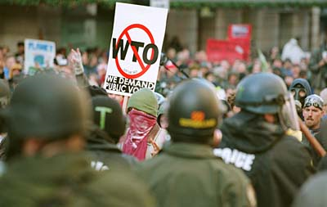

Slide 43
WTO Early Issues
Doha Round
  Began at WTO Ministerial at Doha, Qatar, Fall 2001 (after Sep 11)
  Emphasis on development:
  Cancún Ministerial Sep 2003
    Meeting ended without agreement: Failure!
  December 2015: Nairobi Ministerial meeting
    Ended without reaffirming intent to complete the Doha Round
    Implicitly, admission Round had ended in failure

Slide 44
WTO Early Issues
December 2013: Bali Ministerial salvaged a limited agreement, mainly on Trade Facilitation
December 2015: Nairobi Ministerial agreed on several commitments, including to
  Abolish export subsidies on farm exports.
December 2017: Buenos Aries Ministerial met but accomplished essentially nothing

Slide 45
WTO Early Issues
WTO has also succeeded in negotiating “plurilateral agreements”
  These are agreements the members can sign or not, and are only binding on those who do
  Agreements that have been negotiated:
    Information Technology Agreement (1995 with update 2015)
    Financial Services Agreement
    Basic Telecommunication Services Agreement
    Anti-Counterfeiting Trade Agreement

Slide 46
WTO Disputes
There have been 596 disputes brought to the WTO since its creation in 1995 (as of 9/20/20)
Two of the more notable were
  EU ban on hormone treated beef (ruled by WTO to have no scientific basis)
  US shrimp-turtle import prohibition (struck down by WTO)

Slide 47
WTO Disputes
Boeing-Airbus (see our earlier readings)
COOL dispute (Country of Origin Labeling)
  US requires it on meat
  Canada and Mexico objected
  US lost
China’s “Market-economy status”
  China lost

Slide 48
Trump and the WTO
Oct 25, 2017, on Fox interview with Lou Dobbs:
  “The WTO, World Trade Organization, was set up for the benefit for everybody but us.”
  “we lose the lawsuits, almost all of the lawsuits … within the WTO”
In fact, like other countries, US
  Wins most of the cases it brings
  Loses most the cases brought against it
Since 1995, in all cases complainant has won 90%
  As complainant, US has won 91%
  As respondent, US has lost 89%

Slide 49
Trump and the WTO
National-Security Tariffs (on steel, aluminum)
How will WTO rule?
    If no, Trump will further blame WTO
    If yes, other countries will use that excuse
WTO provision:
  Article XXI: “[n]othing in this Agreement shall be construed . . . to prevent any contracting party from taking any action which it considers necessary for the protection of its essential security interests . . . taken in time of war or other emergency in international relations[.]”

Slide 50
Trump and the WTO
National-Security Tariffs (on steel, aluminum)
How will WTO rule?
    If no, Trump will further blame WTO
    If yes, other countries will use that excuse
WTO provision:
  Article XXI: “[n]othing in this Agreement shall be construed . . . to prevent any contracting party from taking any action which it considers necessary for the protection of its essential security interests . . . taken in time of war or other emergency in international relations[.]”

Slide 51
Trump and the WTO
Dispute Settlement Body (DSB)
  Lacks a quorum since Dec 11, 2019
  Trump blocked all new appointments
Without DSB no case can finish if it is appealed
Other countries are forming an alternative mechanism
  See Amerjee

Slide 52
Trump and the WTO
Trade war with China
  Tariffs levied under US Section 301 not consistent with GATT/WTO
  WTO panel ruled against US Sep 15, 2020
    Panel: “Trump’s tariffs violated several global rules” (NYT)
  Case cannot be completed if US appeals
  Even without that, would WTO permission for China to levy tariffs be meaningful?

Slide 53
Trump and the WTO
Lighthizer (NYT 9/15/2020)
  “This panel report confirms what the Trump administration has been saying for four years: The W.T.O. is completely inadequate to stop China’s harmful technology practices”
  “Although the panel did not dispute the extensive evidence submitted by the United States of intellectual property theft by China, its decision shows that the W.T.O. provides no remedy for such misconduct.”

Slide 54
Pause for Discussion

Slide 55
  Questions on Amerjee
What does MPIA stand for, and why was the MPIA needed?
What countries will be bound by the MPIA? (Who will not be bound?)
Who will decide cases?
Will this work any better than the Appellate Body? Why or why not?

Slide 56
  Questions on Economist,
  “How to Rescue the WTO”
What have been the recent US actions that either undermine the WTO or make it appears irrelevant?
How has China caused problems for the world trading system?
Must reform be agreed by all WTO members?
Why would China agree to reform?

Slide 57
Other International Institutions
IMF (International Monetary Fund)
World Bank (International Bank for Reconstruction and Development)
G-7, G-8, G-20
OECD (Organization for Economic Cooperation and Development)
EU (European Union)

Slide 58
Other International Institutions
United Nations
  UNCTAD (United Nations Conference on Trade and Development)
  ILO (International Labor Organization)
  WIPO (World Intellectual Property Organization)
FTAs (Free Trade Agreements)
  USMCA (United States Mexico Canada Agreement)
  CPTPP (Comprehensive and Progressive Agreement for Trans-Pacific Partnership)
  Many others …

